Slide 1

HOSPITAL MANAGEMENT SYSTEM
Team Members:- (7672 Batch)
1. Jagadesh Ram Pokuru
2. Jaya kiruthika . M
3. Kalai Arasu . K
4. Kishor kumar . N
5. Prakash Mutalik
6. Siva Prakasam . M
7. Subhiksha Gomas . A
Guide by ,
Pooja Mehta .

Slide 2

INTRODUCTION
Hospital Management System is a project which aims in developing a computerized system to maintain all the information of hospital entities.
It has the facilities of admin login through which the admin can monitor the whole system.
Admin modules are managing patients ,manage doctors and manage appointments.
Patient modules are find doctors and applied for appointment ,view appointment and view prescription.
Doctor modules are view our appointments ,write prescriptions and view patient details.
Overall this project of ours is being developed to the hospital administration ,maintain the hospital management in the best way possible and also reduce the human efforts.

Slide 3

OBJECTIVES
The main objective of this project is to manage the records of patients, doctors and appointments.
Reduce the paper work and provide the 24*7 accessible website with user-friendly GUI(Graphical User Interface) to manage the records.
Our objective is by using this website patient can search and view doctors profiles and also apply for appointment
This website project is also become useful for doctors for Viewing patient's details and write prescription to patients.

Slide 4

PURPOSE
To manage the hospital administrative work .It helps to patients to find doctors details and take appointment online from anywhere.
This project also helps doctors work such as keep information of patient and appointment bookings and helps in giving prescriptions to patients.

Slide 5

ADVANTAGES
Improve Data Security .
Less Paperwork .
Error-free Administration .
Improves Patient's Experience .
Costs Reduction .
Establish your hospital as technically advanced .

Slide 6

SOFTWARE USED
OPERATING SYSTEM .
ECLIPSE IDE TOOL .
JDK(JAVA DEVELOPMENT KIT) .
IDE(INTEGRATED DEVELOPMENT ENVIRONMENT) .

Slide 7
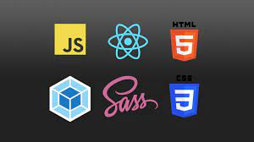
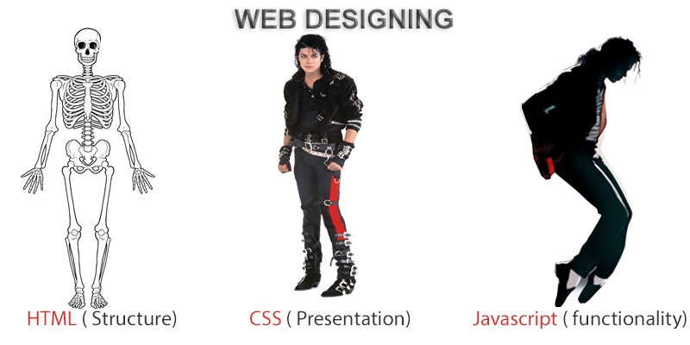
FRONTEND (LANGUAGES USED)
HTML (HYPERTEXT MARKUP LANGUAGE)
CSS (CASCADING STYLE SHEET)
BOOTSTRAP (FRAMEWORK OF CSS AND JS)

Slide 8

BACKEND (LANGUAGES USED)
JAVA PROGRAMMING LANGUAGE
MYSQL (DATABASE)
SPRINGBOOT FRAME
HIBERNATE

Slide 9

HARDWARE USED
PROCESSOR : Minimum i3 .
RAM : Minimum 2GB .
HARD DISK : Minimum 500GB .

Slide 10

MODULES
There are four types of modules :-
Admin
Doctors
Patients
Pharmacy

Slide 11
FUNCTIONAL MODULES
User Authentication Module : The registration and login system has been added so that only authenticated users (Admin , Doctor , Receptionist & pharmacist) can perform their respective functionalities.
Doctor Module : Add Doctor , View Doctors , Search Doctors.
Appointment Module : Add Appointment , View Appointments , Treatment Appointment .
Reception Module : Add Receptionist , View Receptionist , search Receptionists .

Slide 12
FUNCTIONAL MODULES
Patient Module : Add Patient , View Patients .
Bill Module : Make Bill, Download Bill .
Pharmacist Module : Add pharmacist ,View pharmacist , Search Pharmacist
Medicine Module : Add Medicine , Update Medicine , View Medicine, Search Medicine .

Slide 13
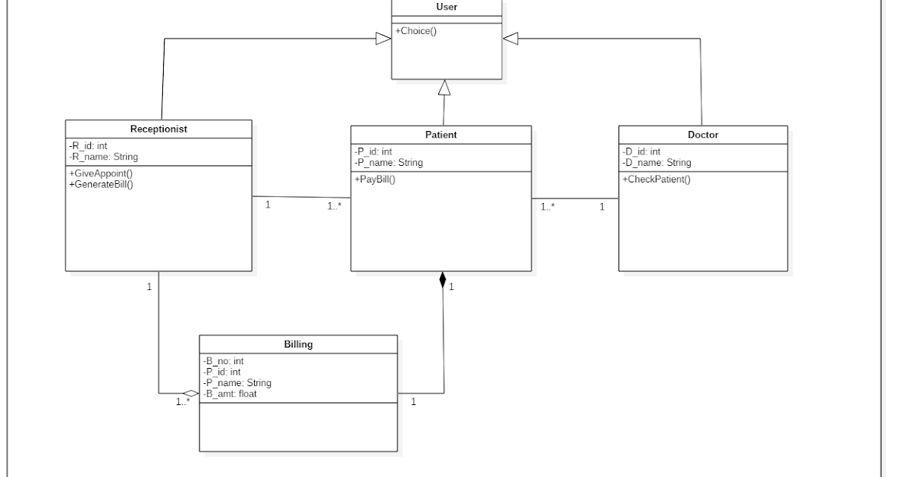
CLASS DIAGRAM

Slide 14
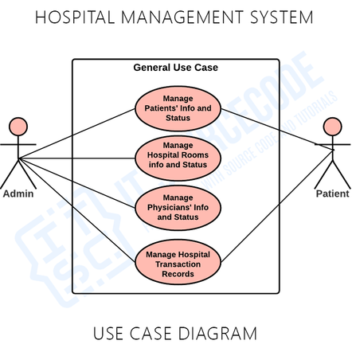

Slide 15
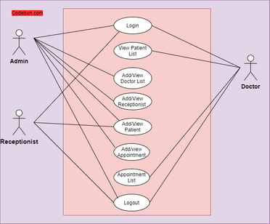
UML DIAGRAM

Slide 16
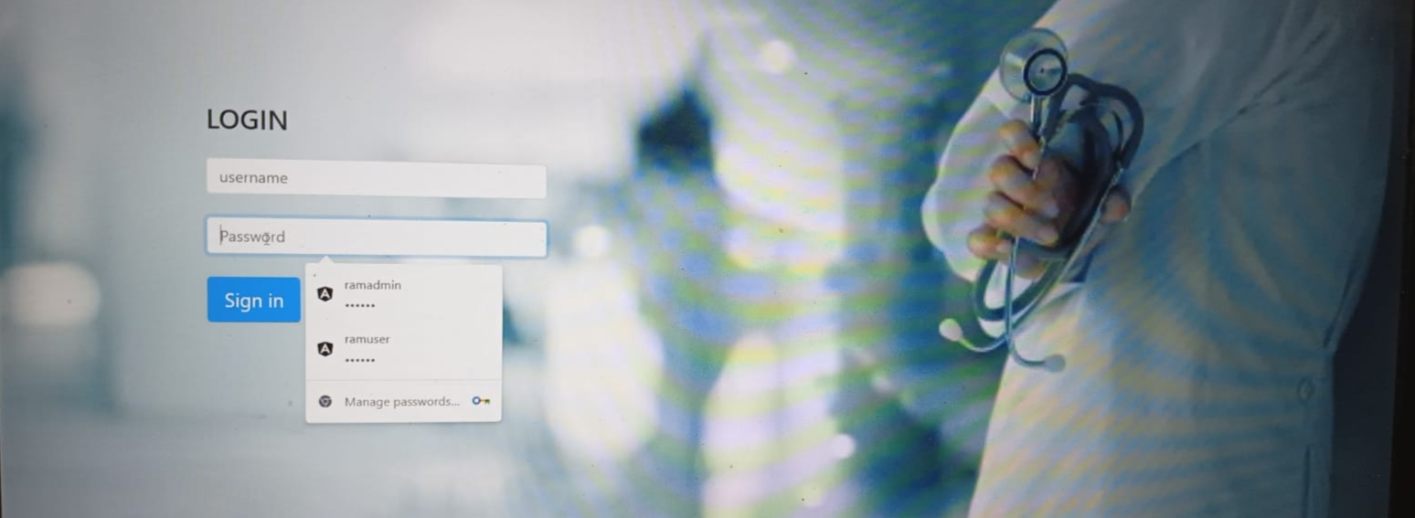

Slide 17


Slide 18
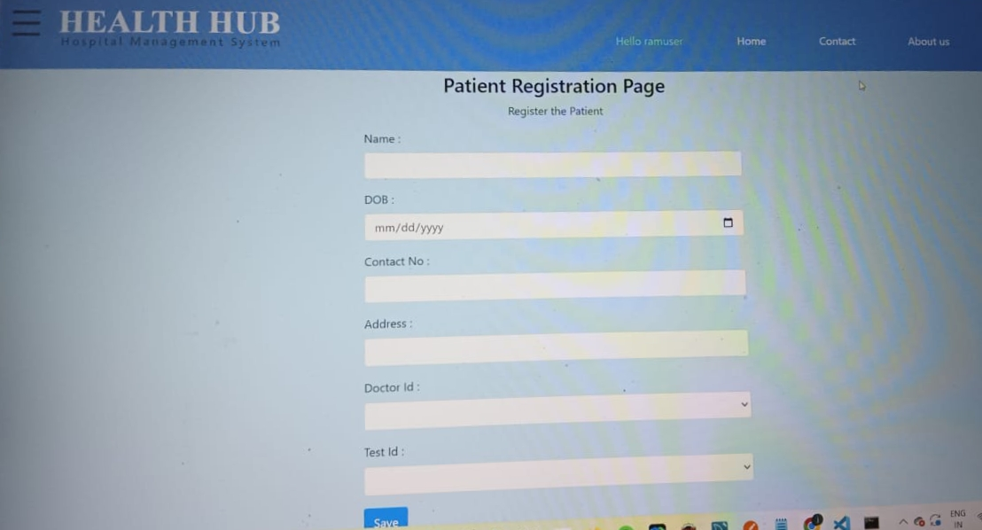

Slide 19
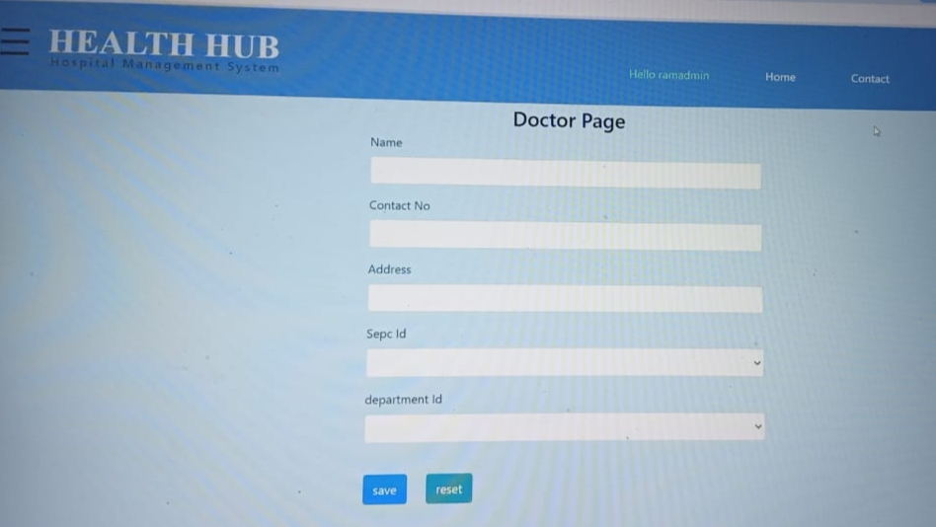

Slide 20
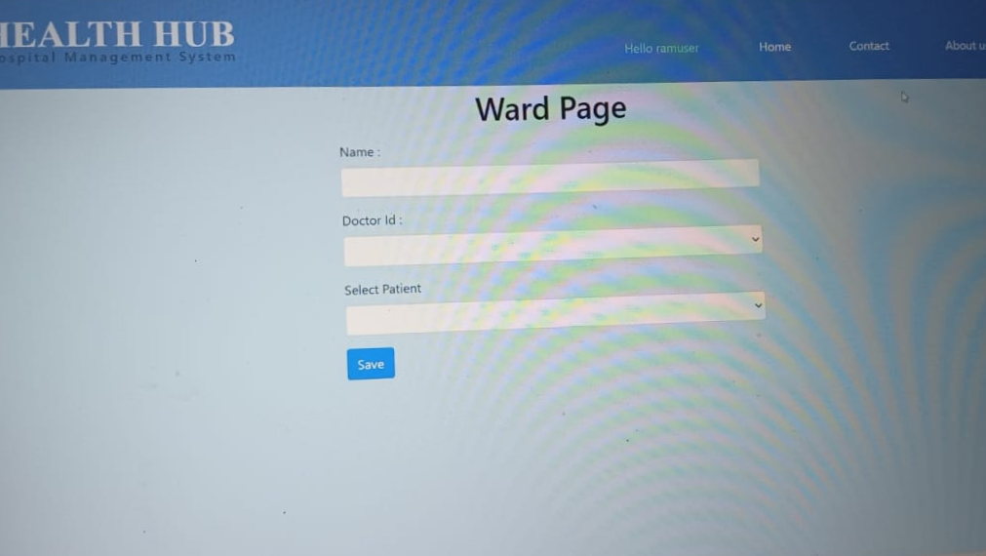

Slide 21
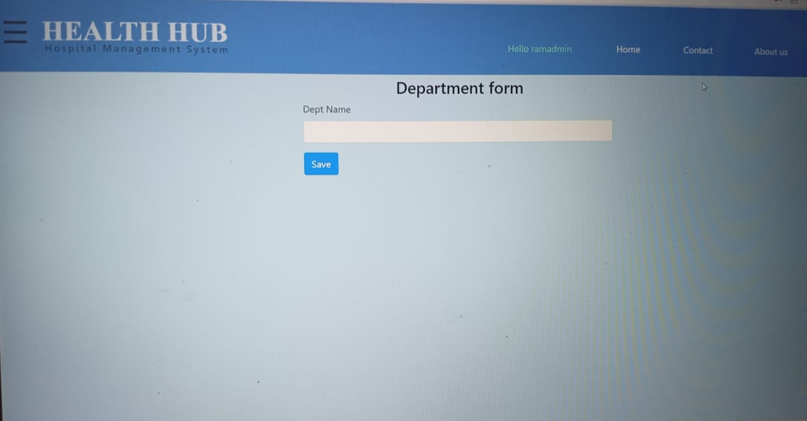

Slide 22
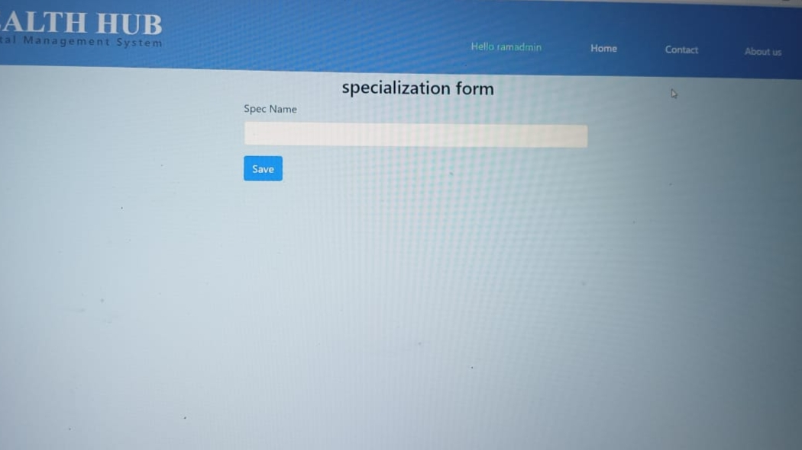

Slide 23
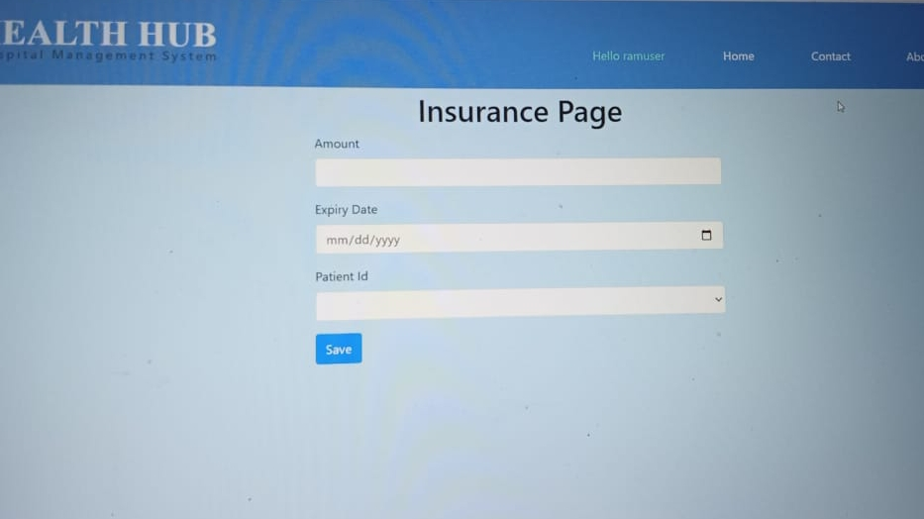

Slide 24
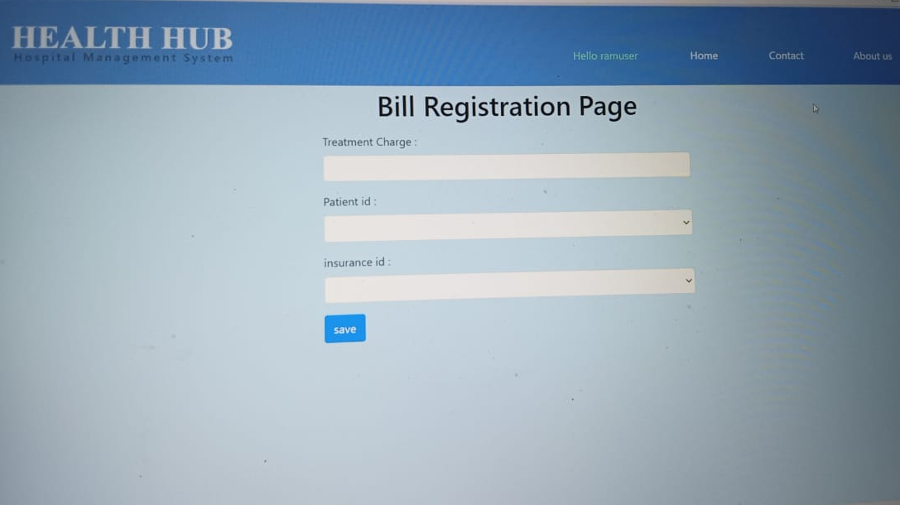

Slide 25
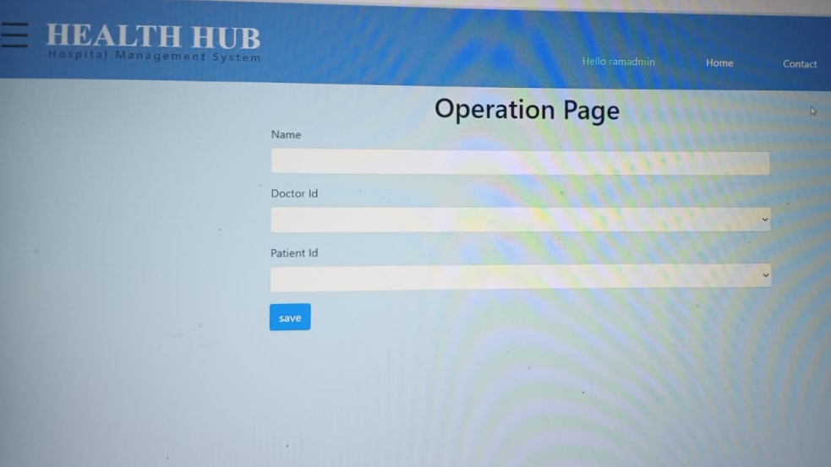

Slide 26
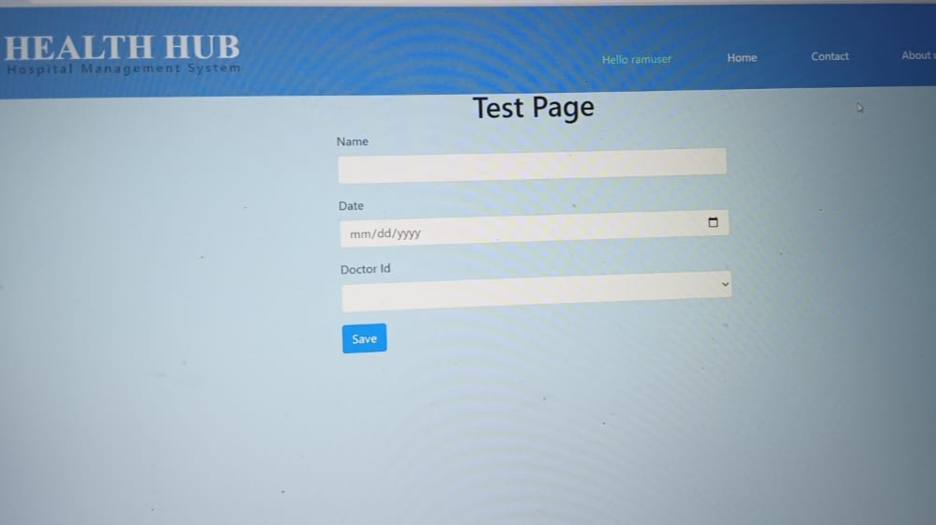

Slide 27
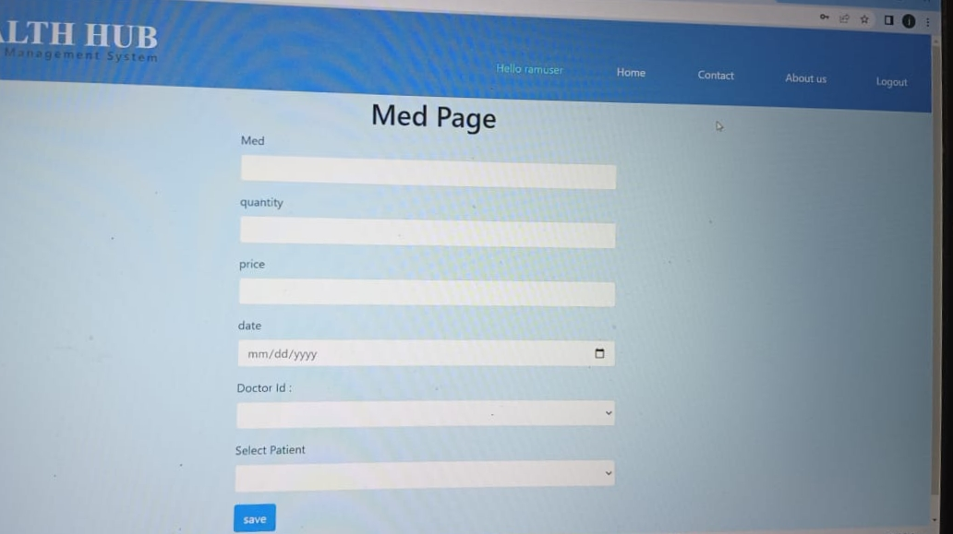

Slide 28
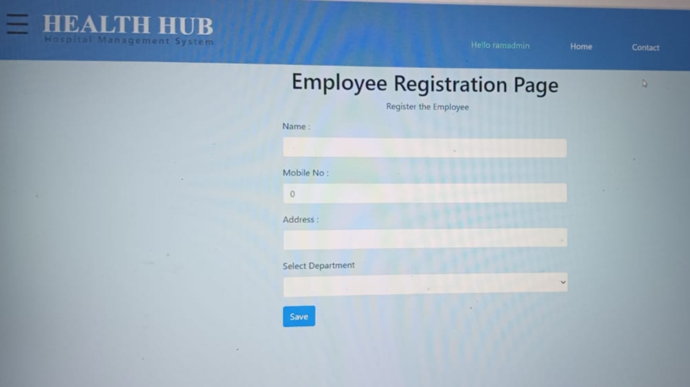

Slide 29
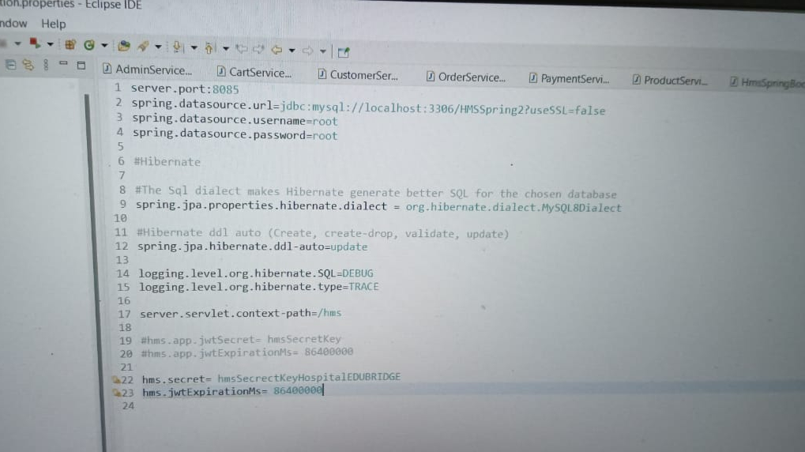

Slide 30
CONCLUSION
The project entitled "Hospital Management System" is developed using HTML ,CSS and Bootstrap as front end and Java language and MYSQL database in back end to computerize the process of online doctor searching and appointments management.
A Hospital Management System is a great way to boost the hospital's productivity and efficiency. It also helps to reduce the workload and burnout rates. According to research ,hospitals that have integrated HMS faced a 19% to 20% reduction in workload. They also noticed that an HMS has streamlined their workflow and increased customer satisfaction.

Slide 31


